Slide 1
Turbine Health Monitoring and Failure Forecasting
Presented by :- K.Pranith Reddy

Slide 2
abstract This Project Develops A Machine Learning Model To Monitor Wind Turbine Health And Predict Potential Failures. By Analyzing Operational Parameters Such As Wind Speed, Temperature, And Vibration, The System Identifies Patterns Leading To Faults. The Model Enables Early Detection Of Failures, Helping To Reduce Downtime, Improve Maintenance Planning, And Enhance Overall Efficiency Of Wind Turbine Operations.

Slide 3
Objective
The Objective Of This Project Is To Develop A Predictive Model For Monitoring The Health Of Wind Turbines And Forecasting Potential Failures. By Analyzing Key Operational Parameters Such As Windspeed, Rotorspeed, Bladeangle, Gearboxtemperature, Generatortemperature, And Vibration, We Aim To:
Identify Patterns Or Conditions That Lead To Failures.
Predict Specific Types Of Failures (E.G., Gearbox, Generator, Blade) Before They Occur.
Improve Turbine Uptime And Optimize maintenance schedules, reducing downtime and operational costs.

Slide 4
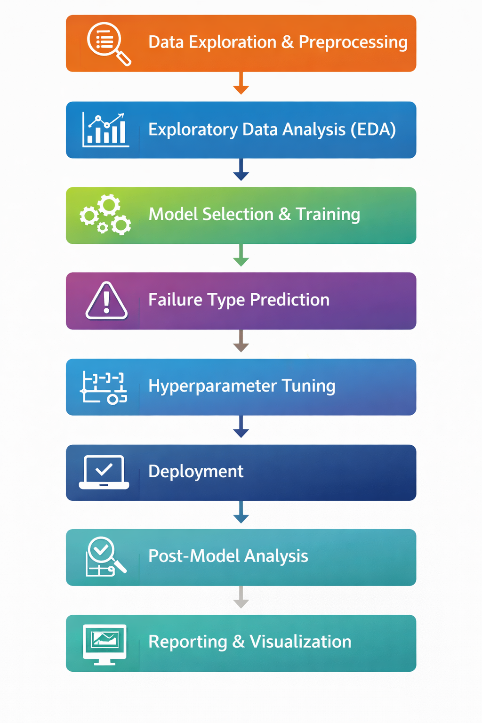
Approach Overview
Data Exploration & Preprocessing
Exploratory Data Analysis (EDA)
Model Selection & Training
Failure Type Prediction
Hyperparameter Tuning
Deployment
Reporting & Visualization
Tools used:- Python

Slide 5
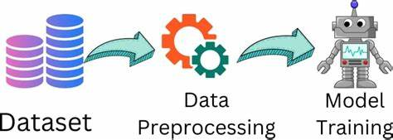
Data Exploration & Preprocessing Load Dataset (9,000 Rows, Multiple Sensors + Failure Labels) Clean Data (Missing Values, Duplicates, Consistency) Encode Categorical Variables (E.G., Faulttype)

Slide 6

Exploratory Data Analysis (EDA)
Descriptive statistics
Correlation analysis (e.g., vibration -- failure)
Visualizations: histograms, scatter plots, box plots
Observations: Failures linked to temperature, vibration, maintenance gap

Slide 7
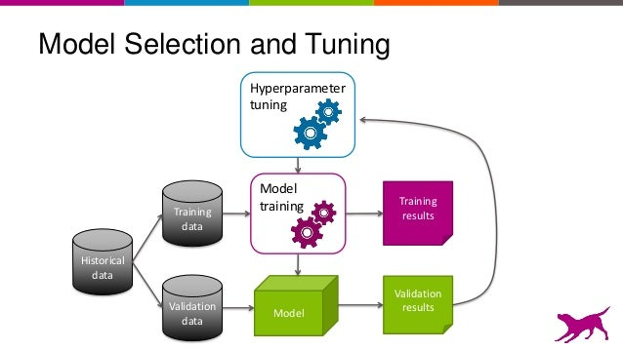
Model Selection & Training
Train/Test split (80/20)
Models tested: Decision Tree, Random Forest, XGBoost
Metrics: Accuracy, Precision, Recall, F1, AUC-ROC
Cross-validation for generalization

Slide 8
Failure Type Prediction
Multiclass classification: FaultType (Gearbox, Generator, Blades)
Models: Random Forest, XGBoost
Evaluated using confusion matrix
Insight : Failures due to multi-factor stress

Slide 9
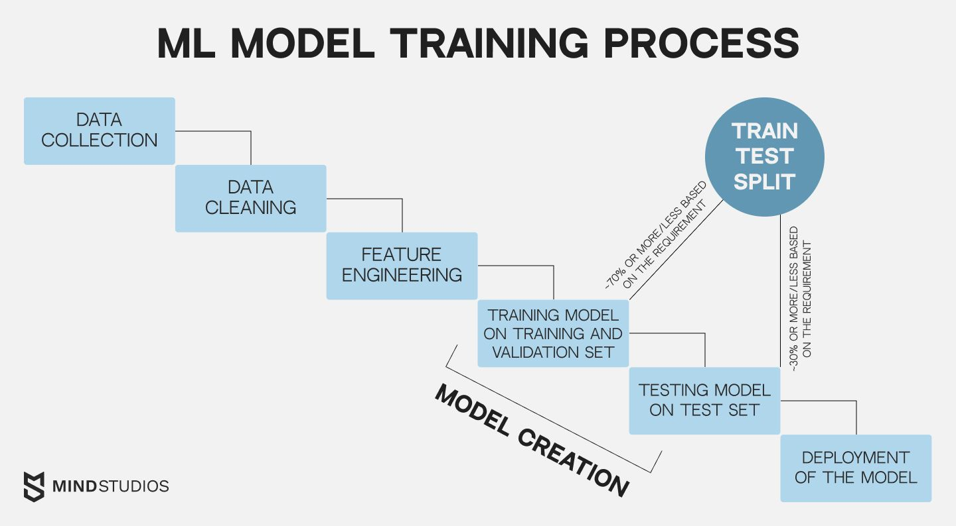

Slide 10

Hyperparameter Tuning
GridSearchCV / RandomizedSearchCV
Optimized Random Forest gave best performance
Why RF?
- Captures complex interactions
- Robust & stable
- Provides feature importance

Slide 11
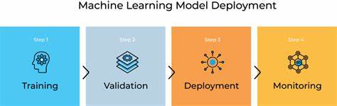
Deployment
Model saved as Pickle (.pkl)
Deployed with Streamlit (app.py)
User inputs sensor values → Predicts Healthy / Need Maintenance
Alerts triggered when risk is high

Slide 12
Reporting & Visualization
Visualizations and reports include:
- Failure probabilities
- Health scores
- Risk watchlist (top turbines)
- Danger bands (safe vs risky thresholds)
Maintenance team gets actionable alerts

Slide 13
Outcomes
Early failure detection = Reduced downtime
Optimized maintenance = Lower costs
Higher turbine reliability & efficiency
Actionable insights for engineers

Slide 14
Conclusion
Predictive maintenance for turbines is feasible and effective
Random Forest chosen for accuracy, stability, and interpretability
Next steps:
- Integrate live streaming data
- Enhance IoT dashboards
- Refine thresholds for real-time alarms

Slide 15
tHANK you!

